Slide 1

.NET
Lecturer
Rokas Slaboševičius
Data

Slide 2


Getting to know
.NET
Introduction - name
Hobby/activity you can't imagine your day without
Experience in IT and computers
Why did I choose C# and programming?
What are your expectations after the course?

Slide 3

Agreements
.NET
Attendance marking will take place after 20min from the start of the lesson
We will take breaks with exceptions every 50min after 10min
If you have questions, don't be afraid to raise them and if necessary interrupt - discussion will help to ensure concentration and not straying from the "path"
Turn on the cameras whenever conditions allow
Programming terms will be mentioned in English
We will write the variables in the code in English

Slide 4
Lesson structure
.NET
Repeating the uncertainties of the previous topic
1x-2x
Theory
Practice
Practice presentations
Summary

Slide 5

Course start tools
.NET
Visual Studio Community
Git
GitBash

Slide 6
Today you will learn
.NET
Preparing Visual Studio
Visual Studio GUI analysis
01
04
NET framework overview
Working on a C# project
02
05
C# programming language
Downloading the code - GitHub
03
06

Slide 7
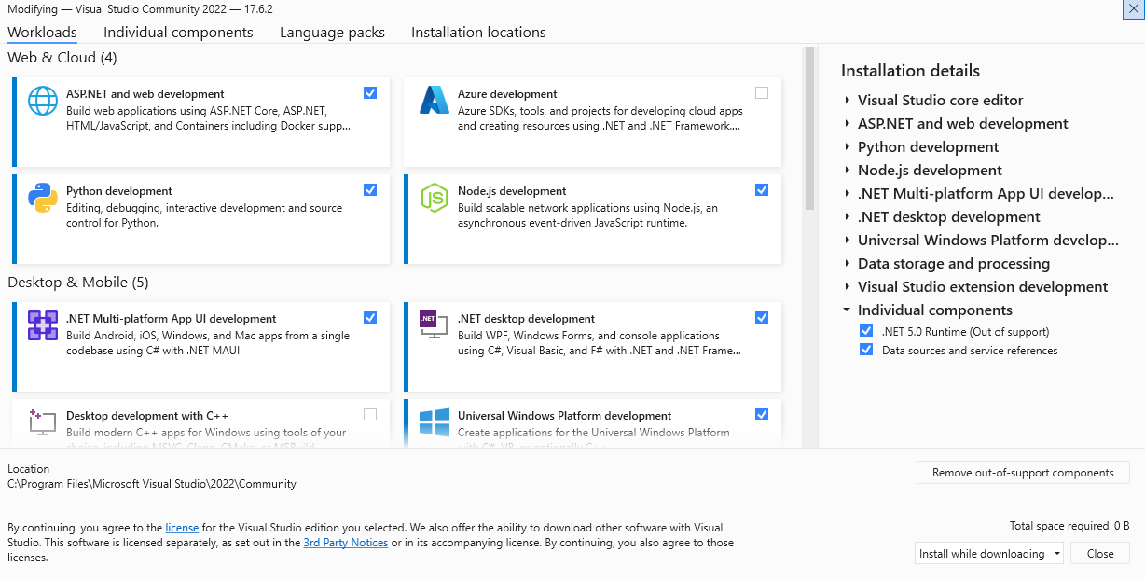
Preparing Visual Studio
.NET
Go to www.google.lt
Enter Visual Studio download
Choose Community Edition
Press the download button
We share the screen and go through the necessary components with the trainer

Slide 8

Overview of the .NET framework
.NET
The .NET platform is a multi-purpose and widely used software development platform developed by Microsoft.
It provides a comprehensive set of tools, libraries and runtime environments for developing different types of applications - from web and desktop apps to mobile and cloud-based solutions.
The main goal of .NET is to allow developers to efficiently create robust, extensible and cross-platform applications.

Slide 9
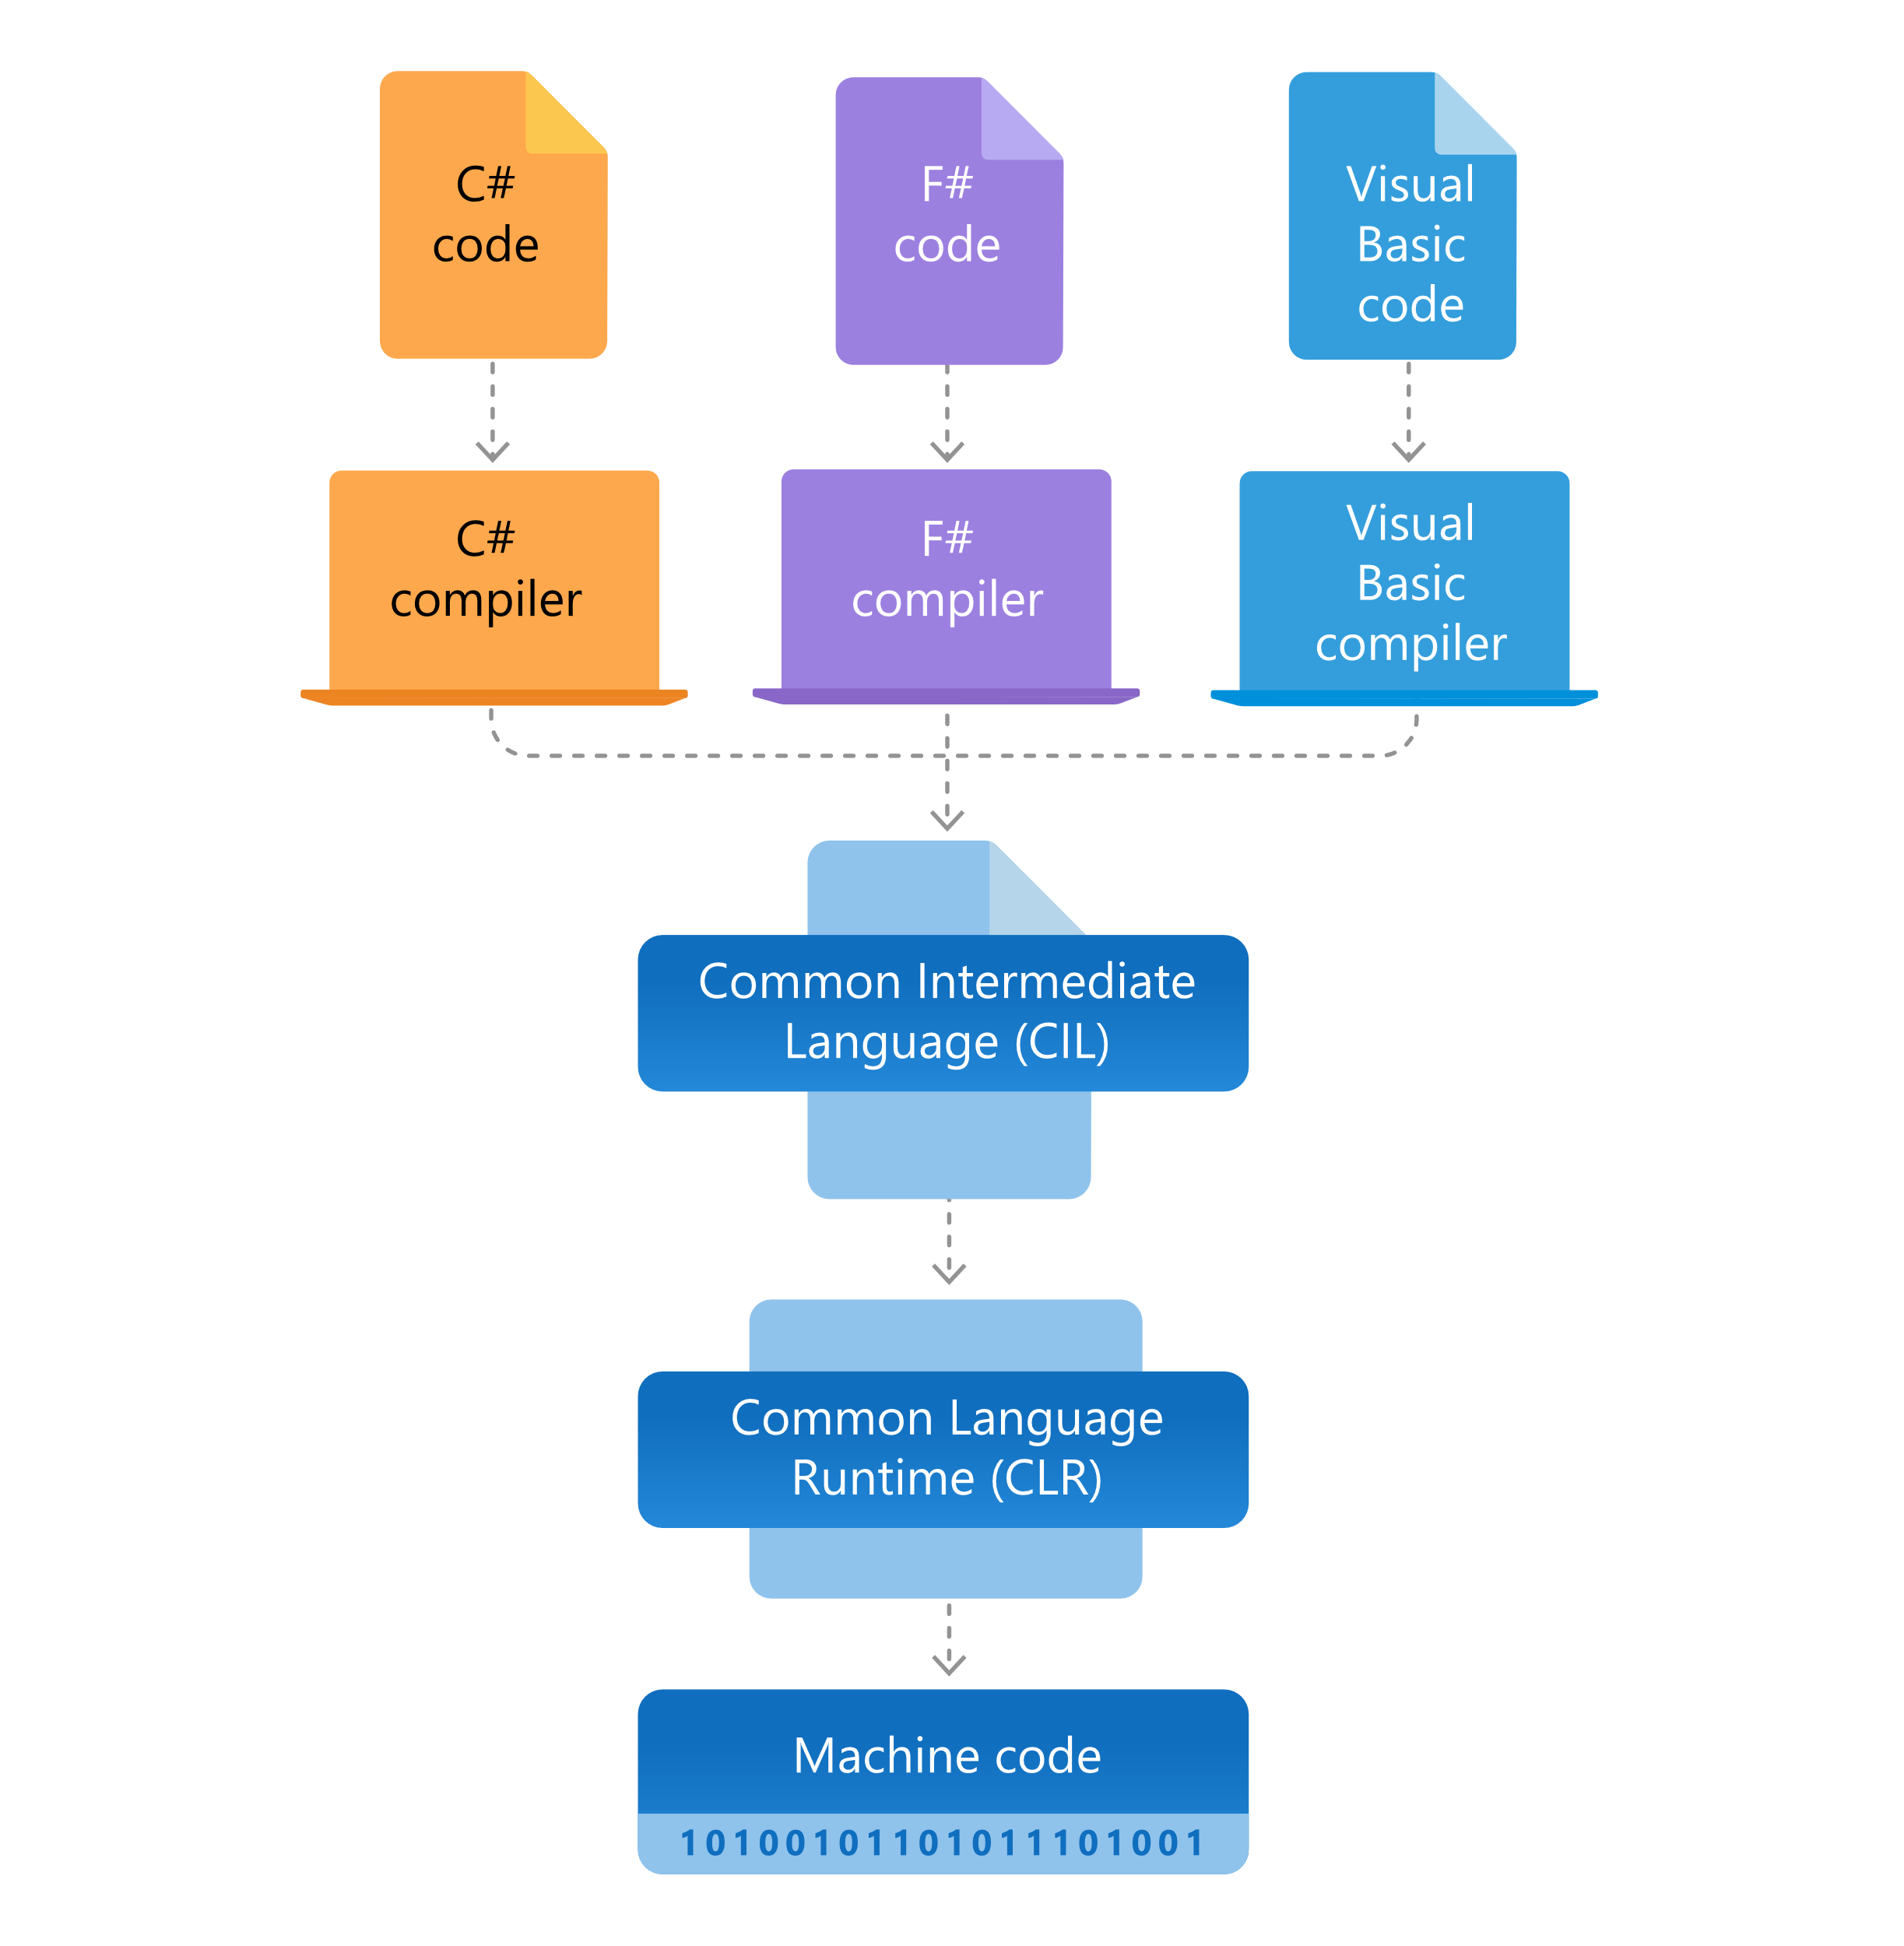
Overview of the .NET framework
.NET
One of the most important features of the .NET platform is its support for multiple programming languages.
Developers can choose from several languages, such as C#, Visual Basic or F#, to develop applications using the .NET platform.
This flexibility allows developers to use their existing skills to choose the language that best suits their project requirements.

Slide 10

Overview of the .NET framework
.NET
The .NET platform provides a rich class library known as the Base Class Library (BCL), which contains a huge collection of ready-made components and functions.
This library provides developers with ready-made components that can be used in applications without having to write them from scratch.

Slide 11

Overview of the .NET framework
.NET
. Another important aspect is the .NET platform's support for cross-platform code.
This means that developers can create applications in a single language and run them on any platform where the .NET framework is installed.
This allows:
Reduce code duplication
Avoid the need for a major redesign when migrating an application to another platform.

Slide 12
Overview of the .NET framework
.NET
The .NET platform also has a powerful set of tools for application development, testing and deployment.
"Visual Studio software is a widely used development environment for creating .NET applications. It provides developers with a user-friendly and powerful interface that helps them efficiently develop, test and deploy applications.
These tools contribute to improving the productivity of the programming process and the quality of applications.

Slide 13

C# programming language
.NET
Simple syntax:
C# has a clear and structured syntax that is easy to understand and write. This makes it easy for beginners to learn to program and write efficient code quickly.
The basics of objectivity:
C# is an object-oriented language, which means that it helps you to build the structure of your applications based on objects. This principle is widely used in programming, so for beginners it's a great place to start.

Slide 14




C# programming language
.NET
Support from a large community:
C# is a popular choice of programming language and there is a large and active community where you can get help and share knowledge and skills.
Suitability for Windows and other platforms:
C# is a programming language developed and supported by Microsoft. It integrates well with the Windows operating system and the Microsoft product ecosystem, making it an excellent choice if you plan to develop applications for the Windows platform.
A wide variety of tools for libraries and sponsors:
C# has a large set of standard libraries that help extend the functionality of applications. In addition, there are many tools and libraries that are community-based and facilitate the programming process.

Slide 15

C# programming language
.NET
Great job opportunities:
C# developers are in high demand in the market. By applying your C# knowledge, you can find a job in companies with a huge choice of application categories.
Integrated support for extensions:
The C# programming language can help you integrate or create your own extensions. This allows you to extend the capabilities of C# and optimise the way you write programs.
A good learning path:
C# is a great program for beginners who want to become programmers. It provides a clear structure and a good foundation that can be transferred to other programming languages.

Slide 16

Visual Studio GUI analysis
.NET
Convenience and reliability:
Visual Studio is a well-optimised programming environment that provides a wide range of facilities and tools to make it easier and faster to develop applications. In addition, it is stable and reliable, ensuring efficient operation.
Good C# support:
Visual Studio provides powerful tools for C# programming. You can use autocomplete, error checking, debugging features and much more to increase your productivity and reduce the risk of errors.

Slide 17
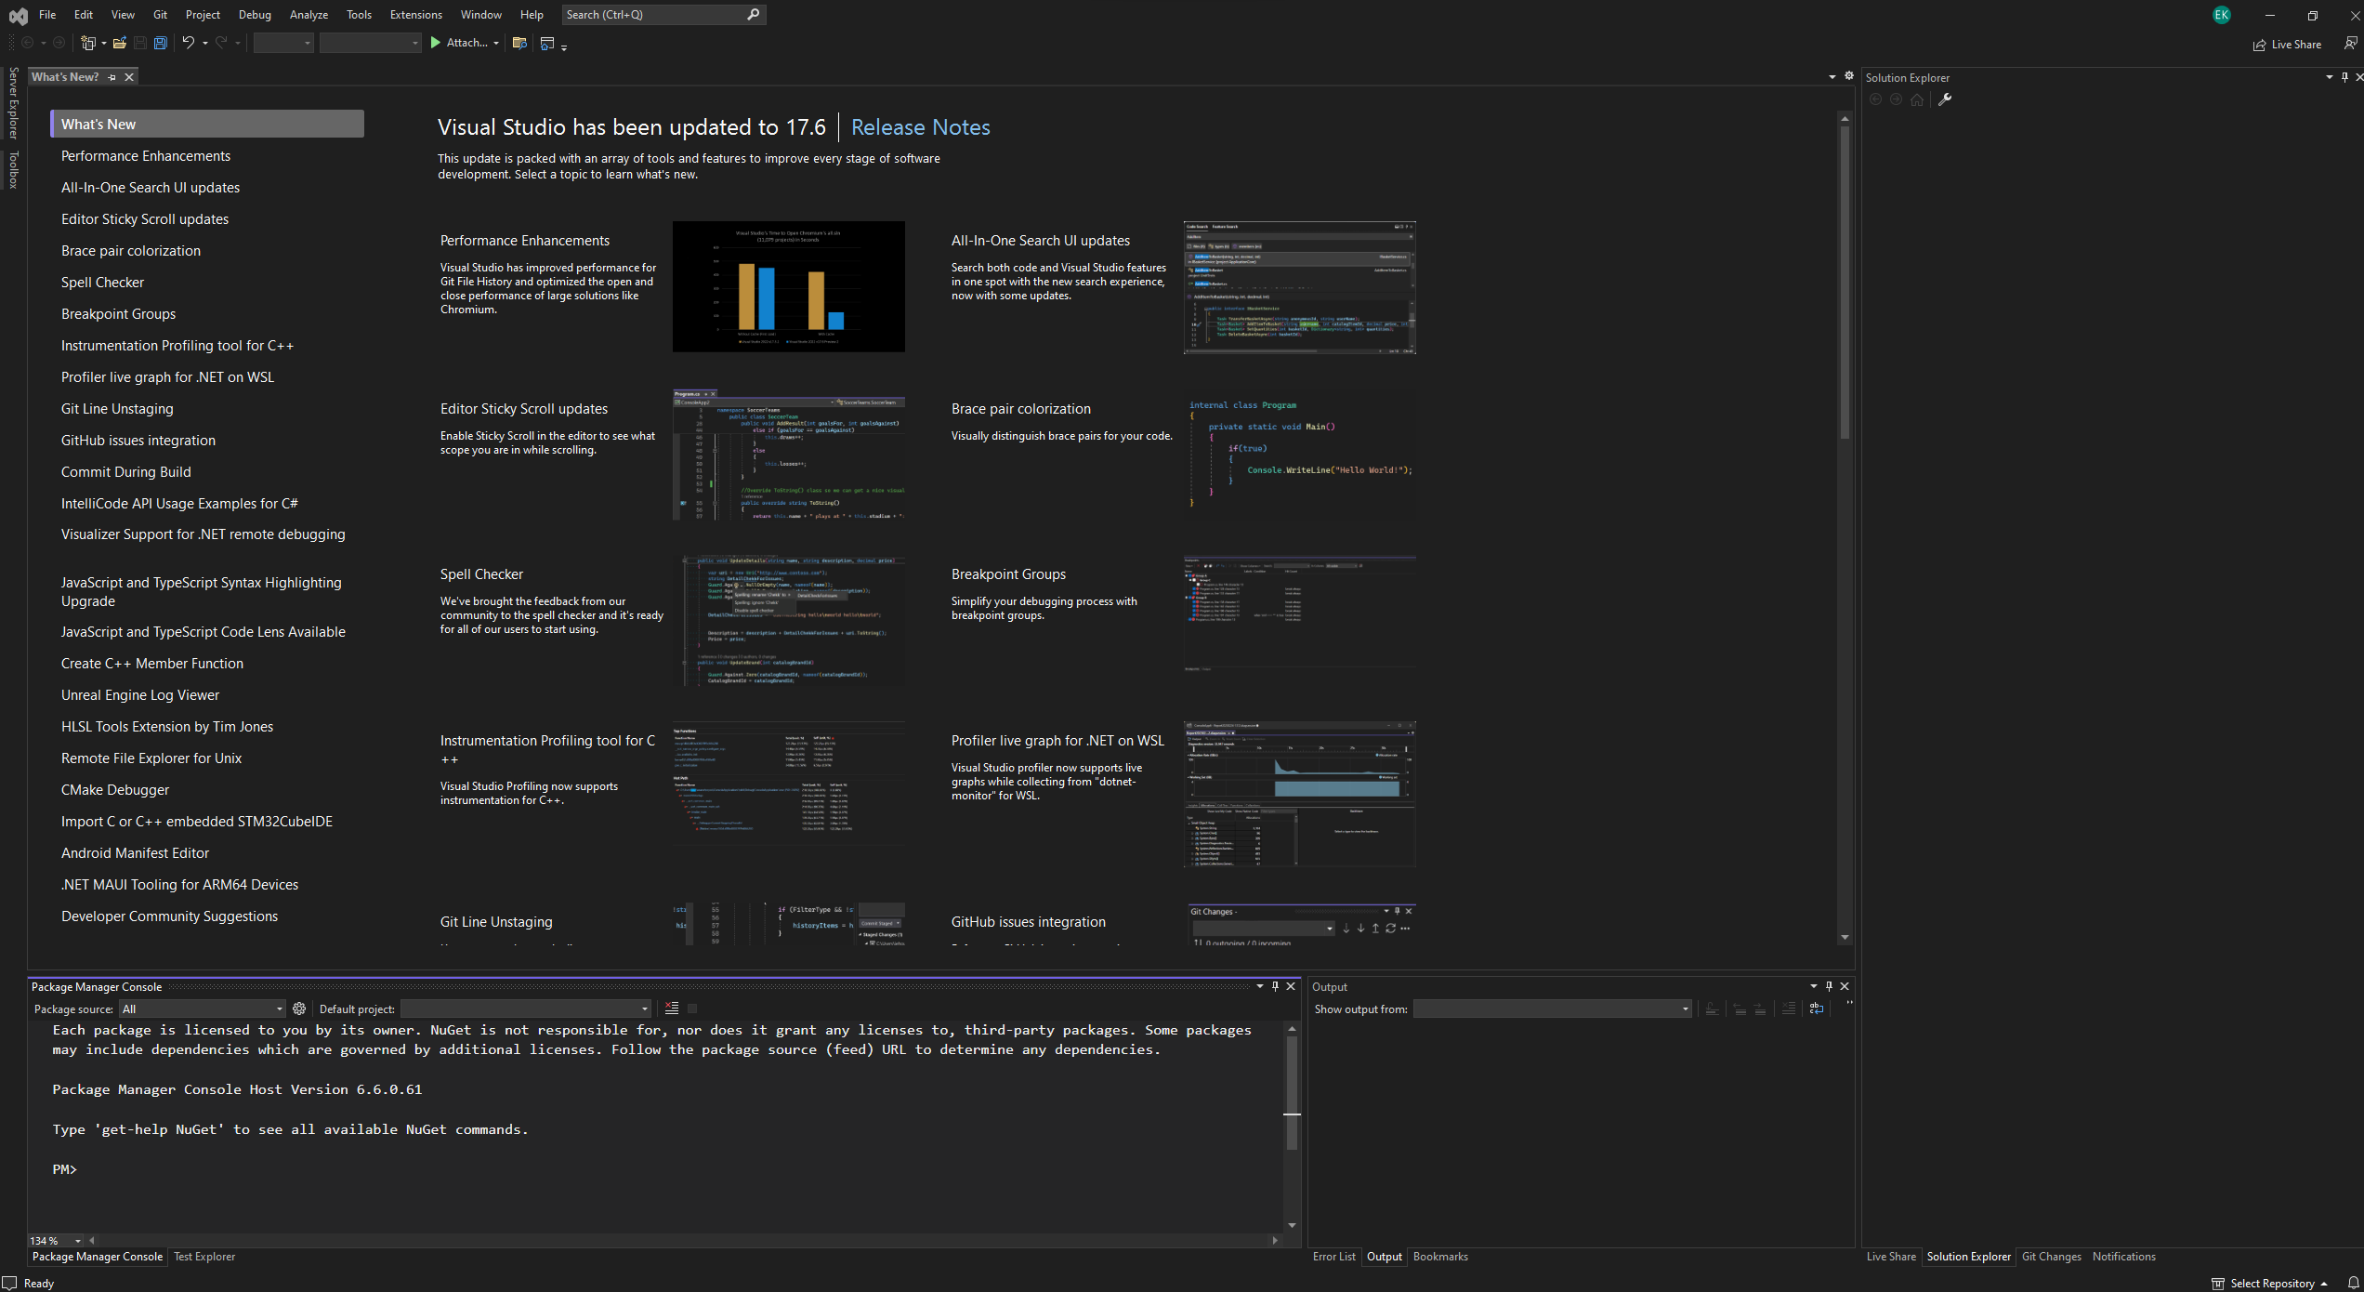
Visual Studio GUI analysis
.NET
Integration with other technologies:
Visual Studio has great integrations with other Microsoft technologies such as Azure Cloud Platform, SQL Server database and many more. This gives you a lot of possibilities to create fully functional application systems.
Support from a large community:
Like C#, Visual Studio is a widely used and popular programming environment. This means there is a large and active community where you can get help, share knowledge and learn new things.

Slide 18


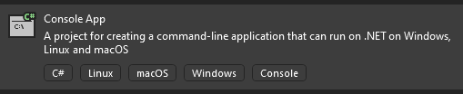
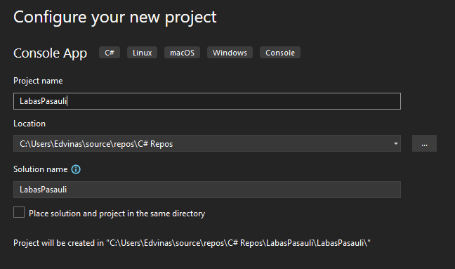
Working on a C# project
.NET
Open the Visual Studio application.
Select "File" from the top menu bar.
From the context menu, select "New" followed by "Project". A new 'Create a new project' dialog box will appear.
In the left search bar, type "Console" and select the "Console App" template.
Next to "Location", specify the desired storage location for the project.
Specify the project name "Name".
Select the desired "Solution name" or leave the default value.
Notes:
.NET CLI | Microsoft Learn

Slide 19
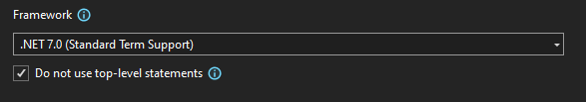

Working on a C# project
.NET
Select the version of Framework you want. The latest available version is usually selected.
Check that the language selected is C# and that the template is "Console App".
Click the "Create" button at the bottom to create a new project.
A new console application project will open with a single file containing the main application.
Notes:
.NET CLI | Microsoft Learn
Select the version of Framework you want. The latest available version is usually selected.
Check that the language selected is C# and that the template is a "Console App".
Click the "Create" button at the bottom to create a new project.
A new console application project will open with a single file containing the main application.

Slide 20
Working on a C# project
.NET
Select the version of Framework you want. The latest available version is usually selected.
Check that the language selected is C# and that the template is a "Console App".
Click the "Create" button at the bottom to create a new project.
A new console application project will open with a single file containing the main application.
Notes:
.NET CLI | Microsoft Learn
Select the version of Framework you want. The latest available version is usually selected.
Check that the language selected is C# and that the template is "Console App".
Click the "Create" button at the bottom to create a new project.
A new console application project will open with a single file containing the main application.

Slide 21

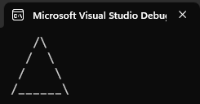
Lecture title
Task 1
Write the program so that you see the picture on the right hand side of the screen

Slide 22
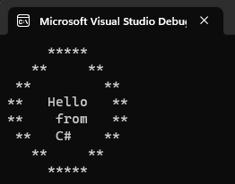
Lecture title
Task 2
Write the program so that you see the picture on the right hand side of the screen

Slide 23
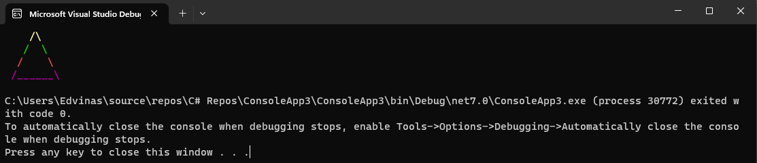
Lecture title
Task 3
Write the program so that you see the picture on the right hand side of the screen

Slide 24
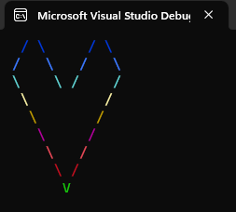
Lecture title
Task 4
Write the program so that you see the picture on the right hand side of the screen

Slide 25
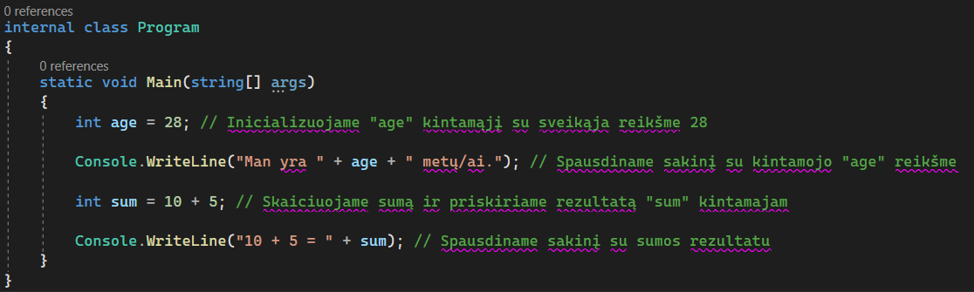

Working on a C# project
.NET
Basic variable types:
Int - Integer
This is a data type that represents integers without any fractional or decimal part. "The 'Int' data type can store both positive and negative numbers within a given range.

Slide 26
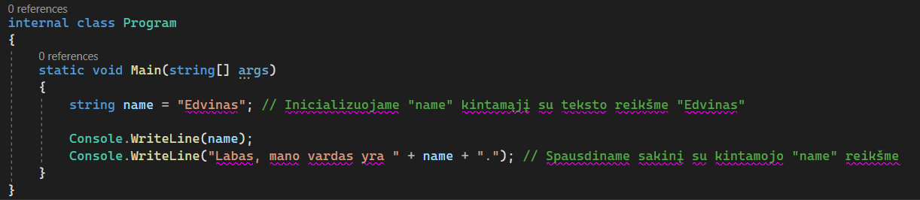

Working on a C# project
.NET
Basic variable types:
String - Text string or sequence of characters
This is a data type used to store and manipulate textual information. Text strings can be made up of any characters such as letters, numbers, special characters, etc.

Slide 27
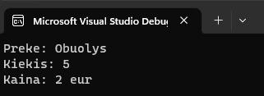
Lecture title
Task 5
Write the program so that you see the image on the right-hand side of the screen. The quantity should be stored in an integer variable type, like variables should be character strings.

Slide 28
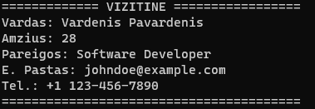
Lecture title
Task 6
Write the program so that you see the image on the right-hand side of the screen. The age should be stored as an integer variable, like variables should be strings of characters.

Slide 29

Code hosting - GitHub
.NET
Go to www.google.lt
Enter GitHub
Click Sign up
Follow the messages and register
Send the teacher the e-mail address you used, so they can invite you to access the repository

Slide 30

.NET
References
www.google.lt
https://github.com
https://git-scm.com/downloads
https://learn.microsoft.com/en-us/dotnet/csharp/
https://visualstudio.microsoft.com/downloads/

